Slide 1
SHARE Initiative Introduction
CEO Quarterly Report
April 2021

Slide 2
Community Investments
Health Related Services (HRS):
Includes Flexible Service and Community Benefit Initiatives
Funded via the YCCO global budget
YCCO has established budgets and projects for HRS investments
Community Prevention & Wellness (CPW) Fund:
Includes braided funding from YCCO and community partners
YCCO contributions can also be counted as HRS investments
Has a separate CPW Committee governance layer
SHARE: Supporting Health for All through Reinvestment
New SDOH-E investments with specific criteria to meet
Cannot be counted as HRS investments as well
Funded via prior year YCCO profits

Slide 3
SHARE Initiative Background
SHARE: Supporting Health for All through Reinvestment
A new requirement for CCO 2.0 via House Bill 4018, that requires CCOs to spend part of their profits in their communities to address health inequities and SDOH-E.
Requirements intend to increase strategic, community-aligned SDOH-E spending, as well as the tracking and transparency on spending.
SHARE Primary Goals:
Safeguard public dollars by requiring a portion of CCO profits be reinvested in their communities.
Improve member and community health by requiring reinvestments go toward upstream factors that impact health (i.e. housing, food, transportation).

Slide 4
SHARE Initiative Timeline
Beginning 2021, CCOs are required to spend a portion of their previous calendar year’s adjusted net income or reserves in excess of regulatory minimums.
For the first two years of SHARE Initiative (profits from Contract Years 2020 and 2021) it is up to each CCO to decide how much of its profits it will contribute to the SHARE Initiative.
OHA expects to revisit use of a formula to prescribe each CCO’s annual SHARE Initiative requirement; earliest implementation would be 2022.
Early iterations indicated a potential range of 10% to 40% of profits.

Slide 5
SHARE Initiative Timeline (cont.)
Year One Milestones:
CCOs must determine a total SHARE Initiative obligation from CY2020 profits no later than April 2021.
CCOs must submit a detailed SHARE Initiative spending plan, inclusive of recipients and SDOH-E domains, no later than June 2021.
CCOs must submit annual SHARE Initiative spend-down reporting each April moving forward; beginning April 2022.
CCOs must submit detailed SHARE Initiative spending plans each June moving forward, inclusive of detailed updates on unspent/unreported funds from prior cycles as well as new designations and spending plans; beginning June 2022.

Slide 6
SHARE Initiative YCCO Reporting
YCCO staff are finalizing YE2020 financials, to confirm total annual profits applicable to the SHARE obligation:
Total CY2020 OHP profits likely to be more than $7 million.
10% to 40% targeted range from OHA equates to a $700,000 to $2.8M possible range of reference for designation.
YCC HRS/SDOH staff workgroup actively cataloging potential investments and community partners for engagement.

Slide 7
Community Approach to Address Social Determinants of Health
CEO Quarterly Report
April, 2021

Slide 8
Community Information Exchange (CIE)
Brief overview of CIEs and Connect Oregon
Discussion
Copyright © 2020 Health Management Associates, Inc. All rights reserved. PROPRIETARY and CONFIDENTIAL

Slide 9
Social Determinates of Health (SDoH)

Slide 10
Challenges We Face When Working to Address SDoH
Understanding needs – social needs screening
Identifying resources to meet the need – knowledge of community resources, entry point, eligibility criteria, capacity
Managing referrals and care coordination – initiation to fully closing the loop
Cross Sector information sharing – closing communication gaps

Slide 11
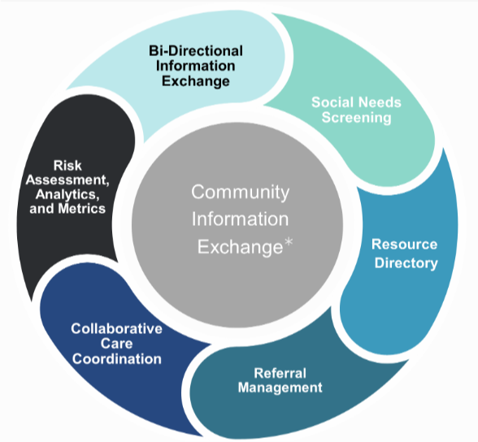
Source: Oregon Health Leadership Council working definition of a Community Information Exchange

Slide 15
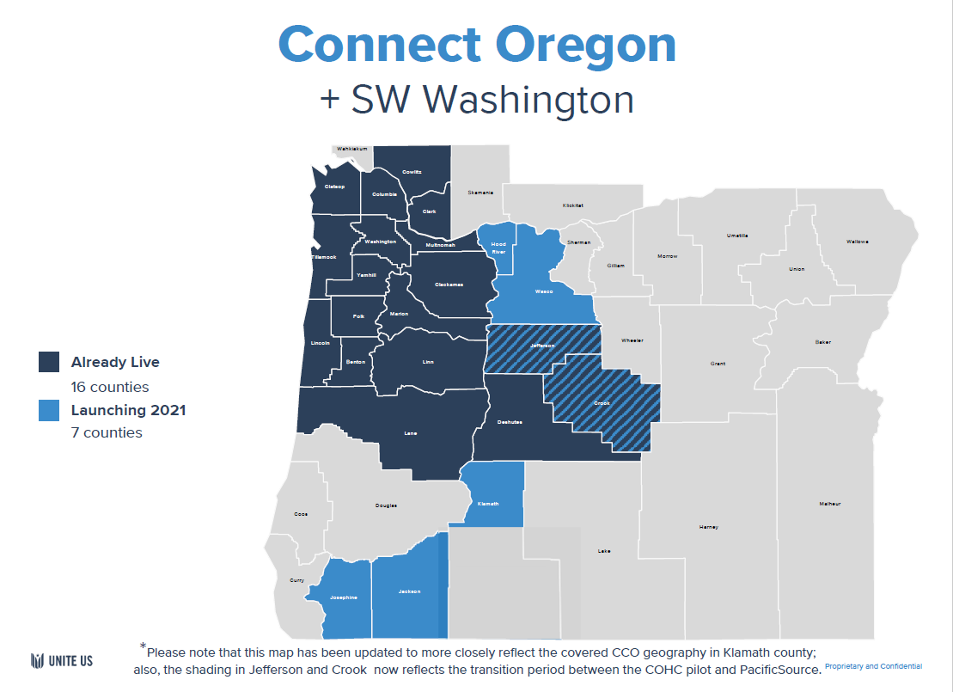
As of 3/19/2021

Slide 17
Interested?
What excites you?
What concerns you?
What questions do you have?

